Slide 1

The Diffie-Hellman protocol
Online Cryptography Course Dan Boneh
Basic key exchange

Slide 2
Key exchange without an online TTP?
Goal: Alice and Bob want shared secret, unknown to eavesdropper
For now: security against eavesdropping only (no tampering)
Alice
Bob
eavesdropper ??
Can this be done with an exponential gap?

Slide 3
The Diffie-Hellman protocol (informally)
Fix a large prime p (e.g. 600 digits)
Fix an integer g in {1, …, p}
Alice
Bob
choose random a in {1,…,p-1}
choose random b in {1,…,p-1}
Bª (mod p) = (g^{b})ª =
k_{AB} = g^{ab} (mod p)
= (gª)^{b} = A^{b} (mod p)
Notes:
“Alice”, A = ga (mod p) ; “Bob”, B = gb (mod p)

Slide 4
Security (much more on this later)
Eavesdropper sees: p, g, A=gª (mod p), and B=g^{b} (mod p)
Can she compute g^{ab} (mod p) ??
More generally: define DH_{g}(gª, g^{b}) = g^{ab} (mod p)
How hard is the DH function mod p?

Slide 5

How hard is the DH function mod p?
Suppose prime p is n bits long.
Best known algorithm (GNFS): run time exp( )
cipher key size modulus size
80 bits 1024 bits
128 bits 3072 bits
256 bits (AES) 15360 bits
As a result: slow transition away from (mod p) to elliptic curves
Elliptic Curve size
160 bits
256 bits
512 bits

Slide 6
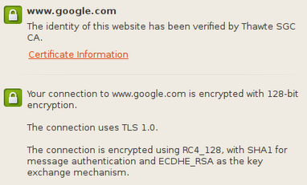
Elliptic curve Diffie-Hellman

Slide 7
Insecure against man-in-the-middle
As described, the protocol is insecure against active attacks
Alice
MiTM
Bob

Slide 8
Another look at DH
Facebook
gª
g^{b}
g^{c}
g^{d}
Alice
Bob
Charlie
David
⋯
a
b
c
d
K_{AC}=g^{ac}
K_{AC}=g^{ac}
Notes:
For two users: DH. For three users: Joux. Beyond three users ???

Slide 9
An open problem
Facebook
gª
g^{b}
g^{c}
g^{d}
Alice
Bob
Charlie
David
⋯
a
b
c
d
K_{ABCD}
K_{ABCD}
K_{ABCD}
K_{ABCD}
Notes:
For two users: DH. For three users: Joux. Beyond three users ???

Slide 10
End of Segment

